Slide 1
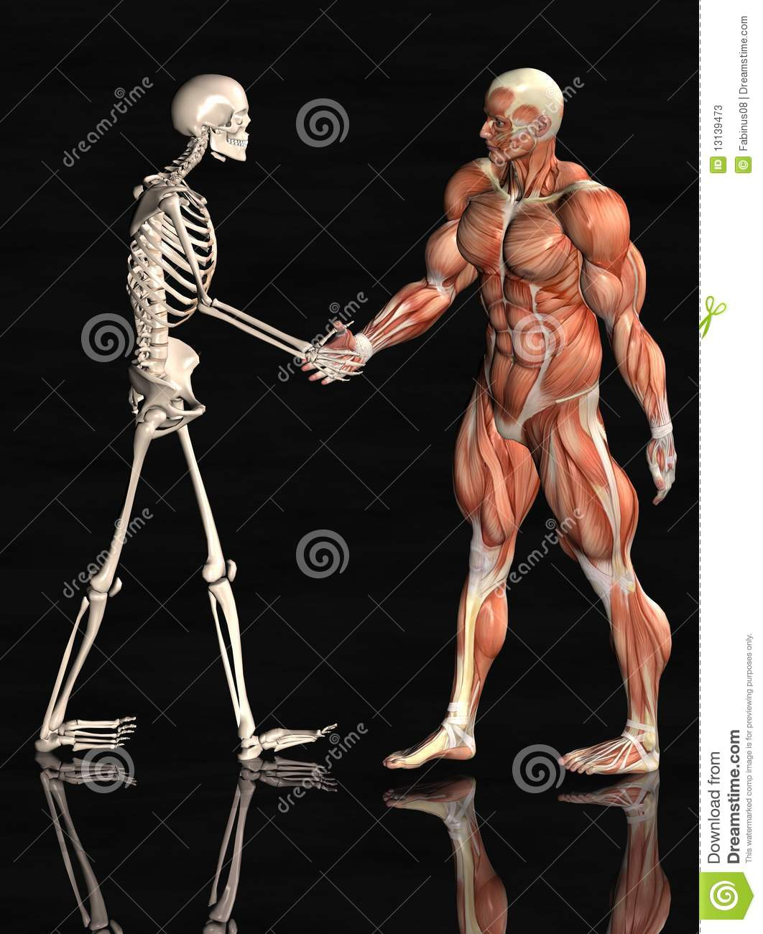
Skeletal and
Muscular Systems
By: Toni Spina, Beau McAndrew, Joey Stickle, Nathan Luis

Slide 2
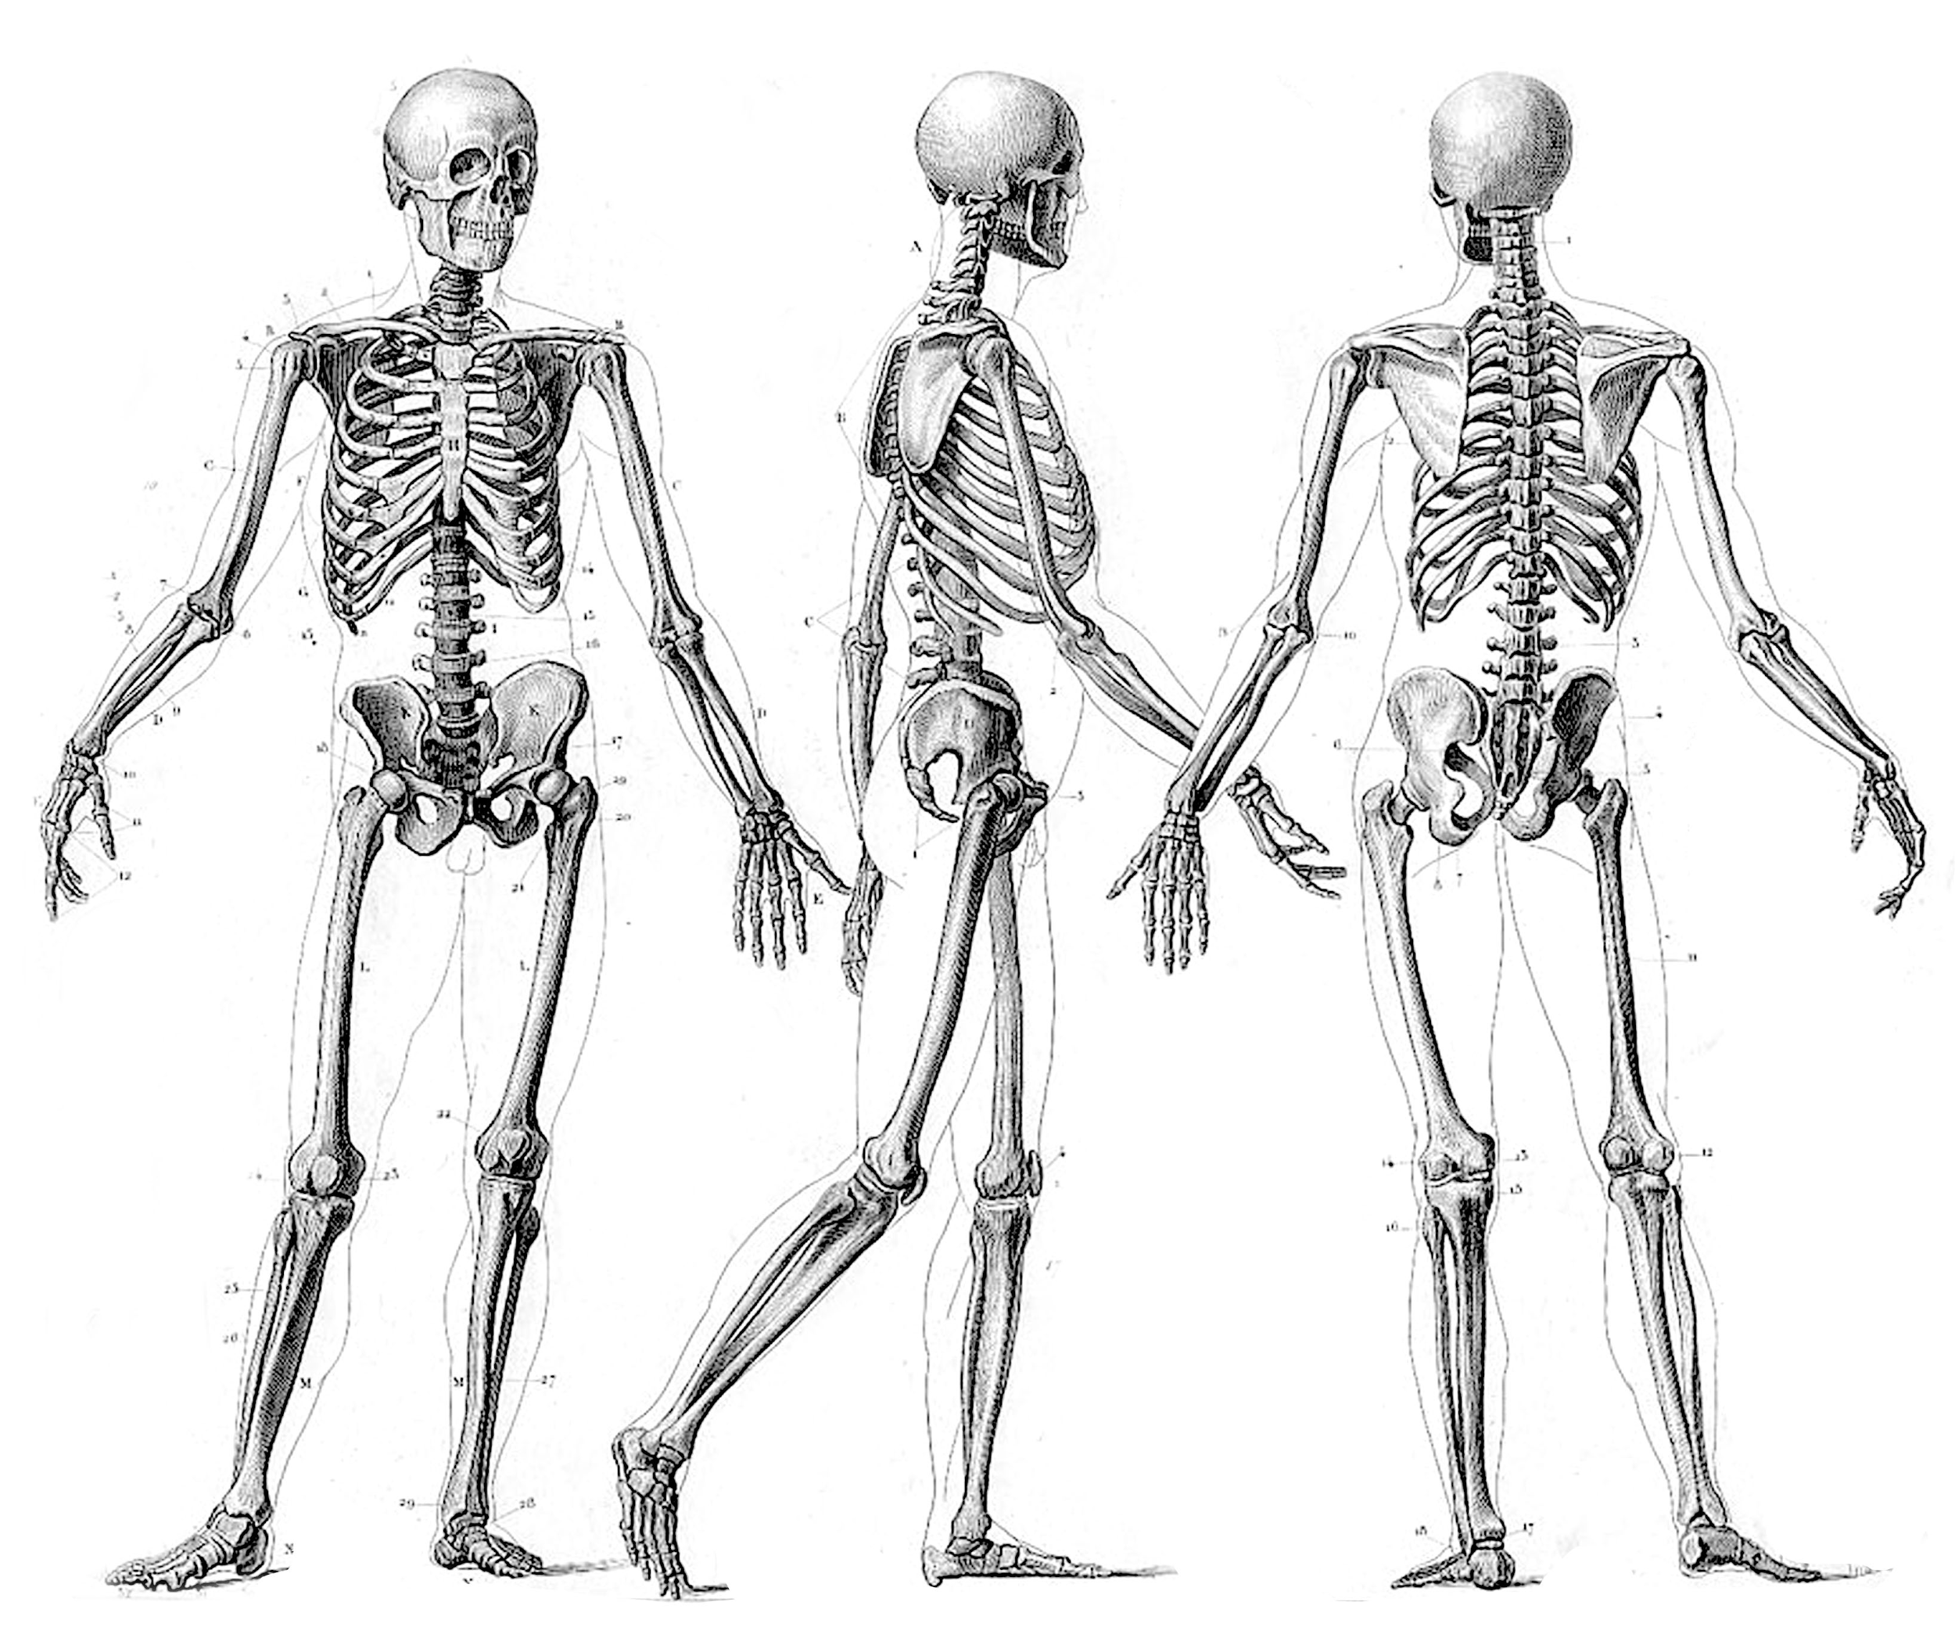
Skeletal System
Made up of bones, cartilage, ligaments, and tendons
Provides support for the body
Protects internal organs
Store mineral reserves
Allows movement
Provide site for cell formation

Slide 3
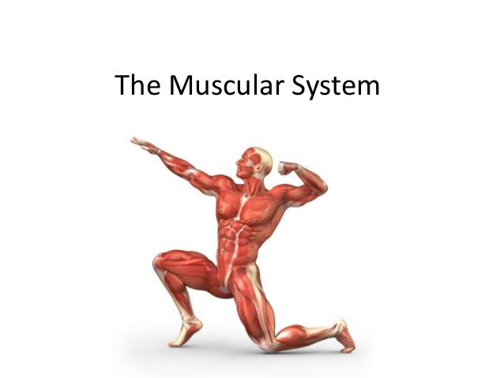
Muscular System
Muscles are made of elastic tissues.
Thousands of small fibers make up each muscle.
There are three types of muscles
Skeletal- control voluntary movement.
Smooth or Visceral- controlled by the unconscious part of the brain. Found in the stomach, blood vessels and small and large intestine. Move food along the digestive tract.
Cardiac- found only in the heart and is responsible for pumping blood into the blood vessels and into the circulatory system.

Slide 4
How They Work Together
The muscles work by pulling on the tendons, which connect muscle to bone
When this happens, the bones move
This is called voluntary movement

Slide 5
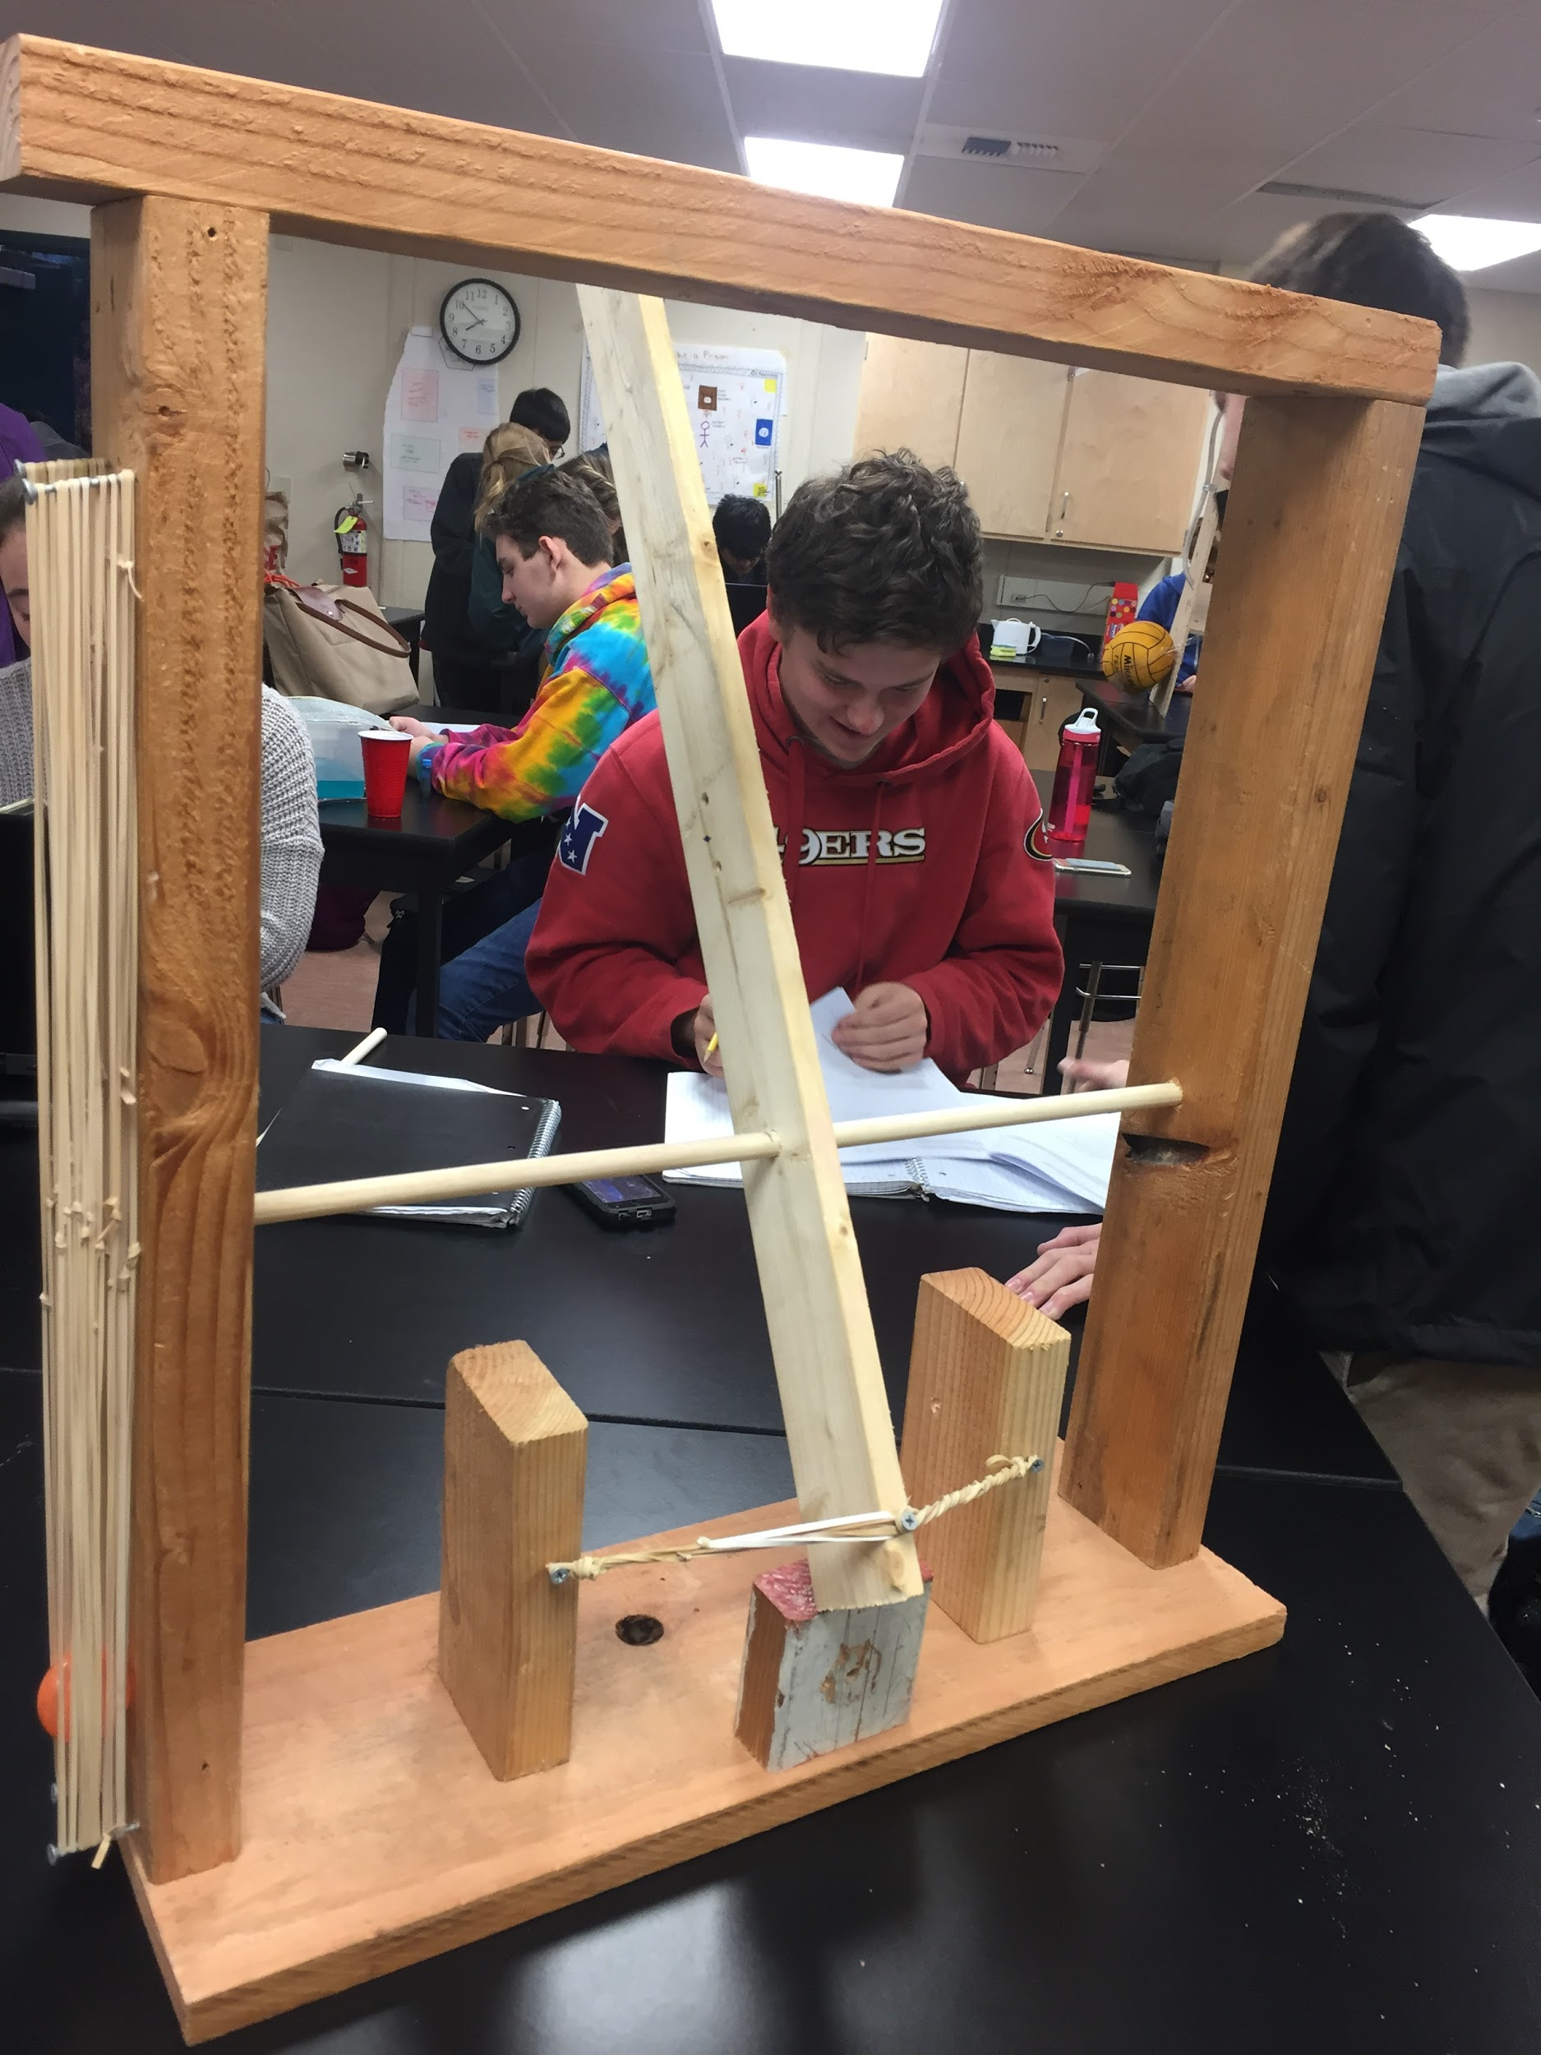
Our Model
Shows how skeletal and muscular systems work together and independently

Slide 6
What Represents What
Our model represents how the skeletal and muscular systems work independently and together.
The wood: bone → it independently provides support.
Rubber bands: skeletal and smooth muscles → it can exert a force
The clay: cartilage → it supports weight
The screws: tendons and ligaments → provide joint support and connect muscle to bone
The wood wound up by rubber band: the skeletal and muscular systems that work together to allow you to perform voluntary movements.
The smooth muscle: rubber bands with a ball between them → shows how the digestive system moves food through the digestion system.

Slide 7
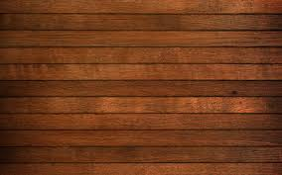
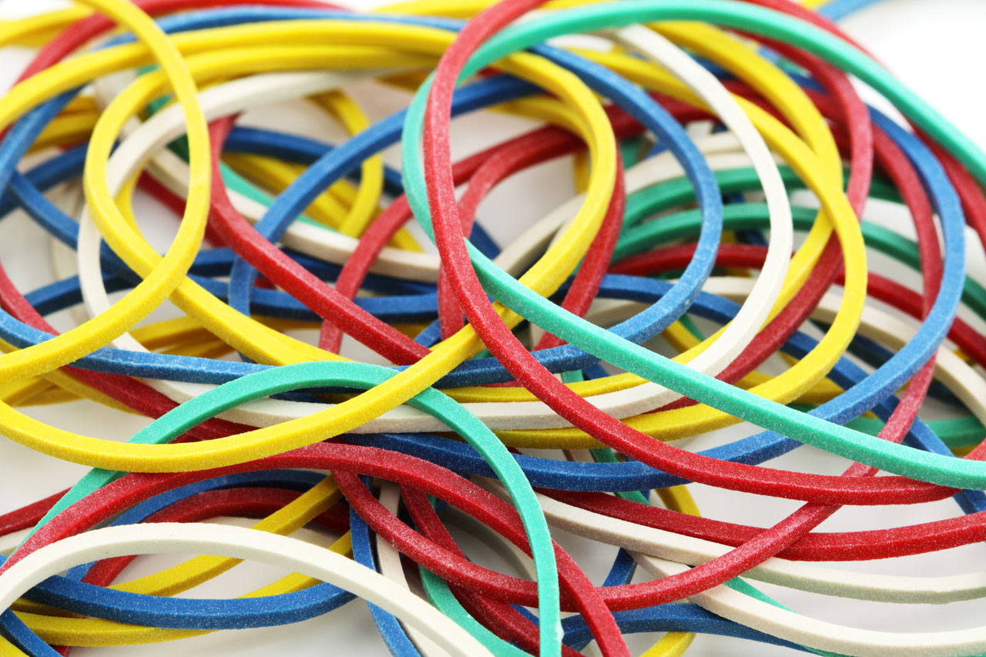
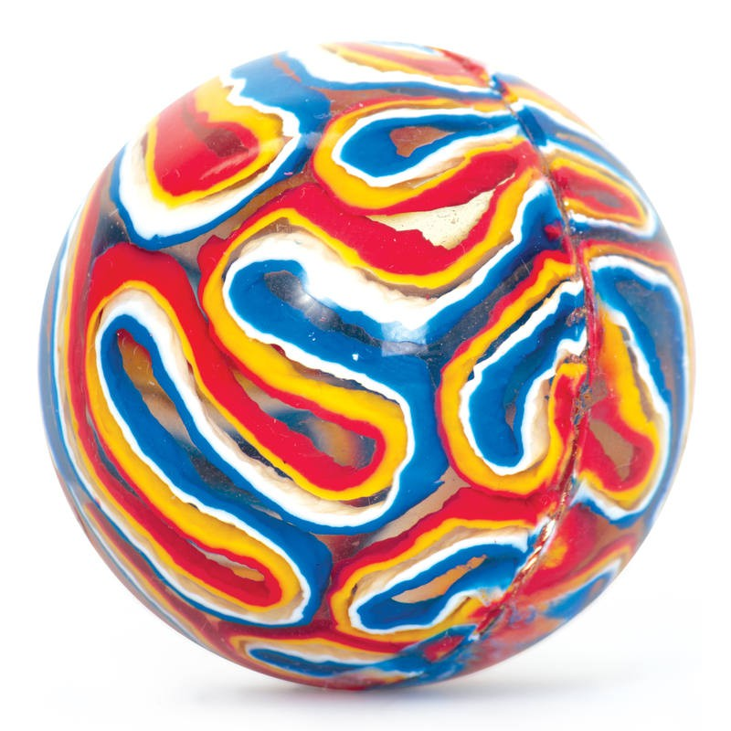
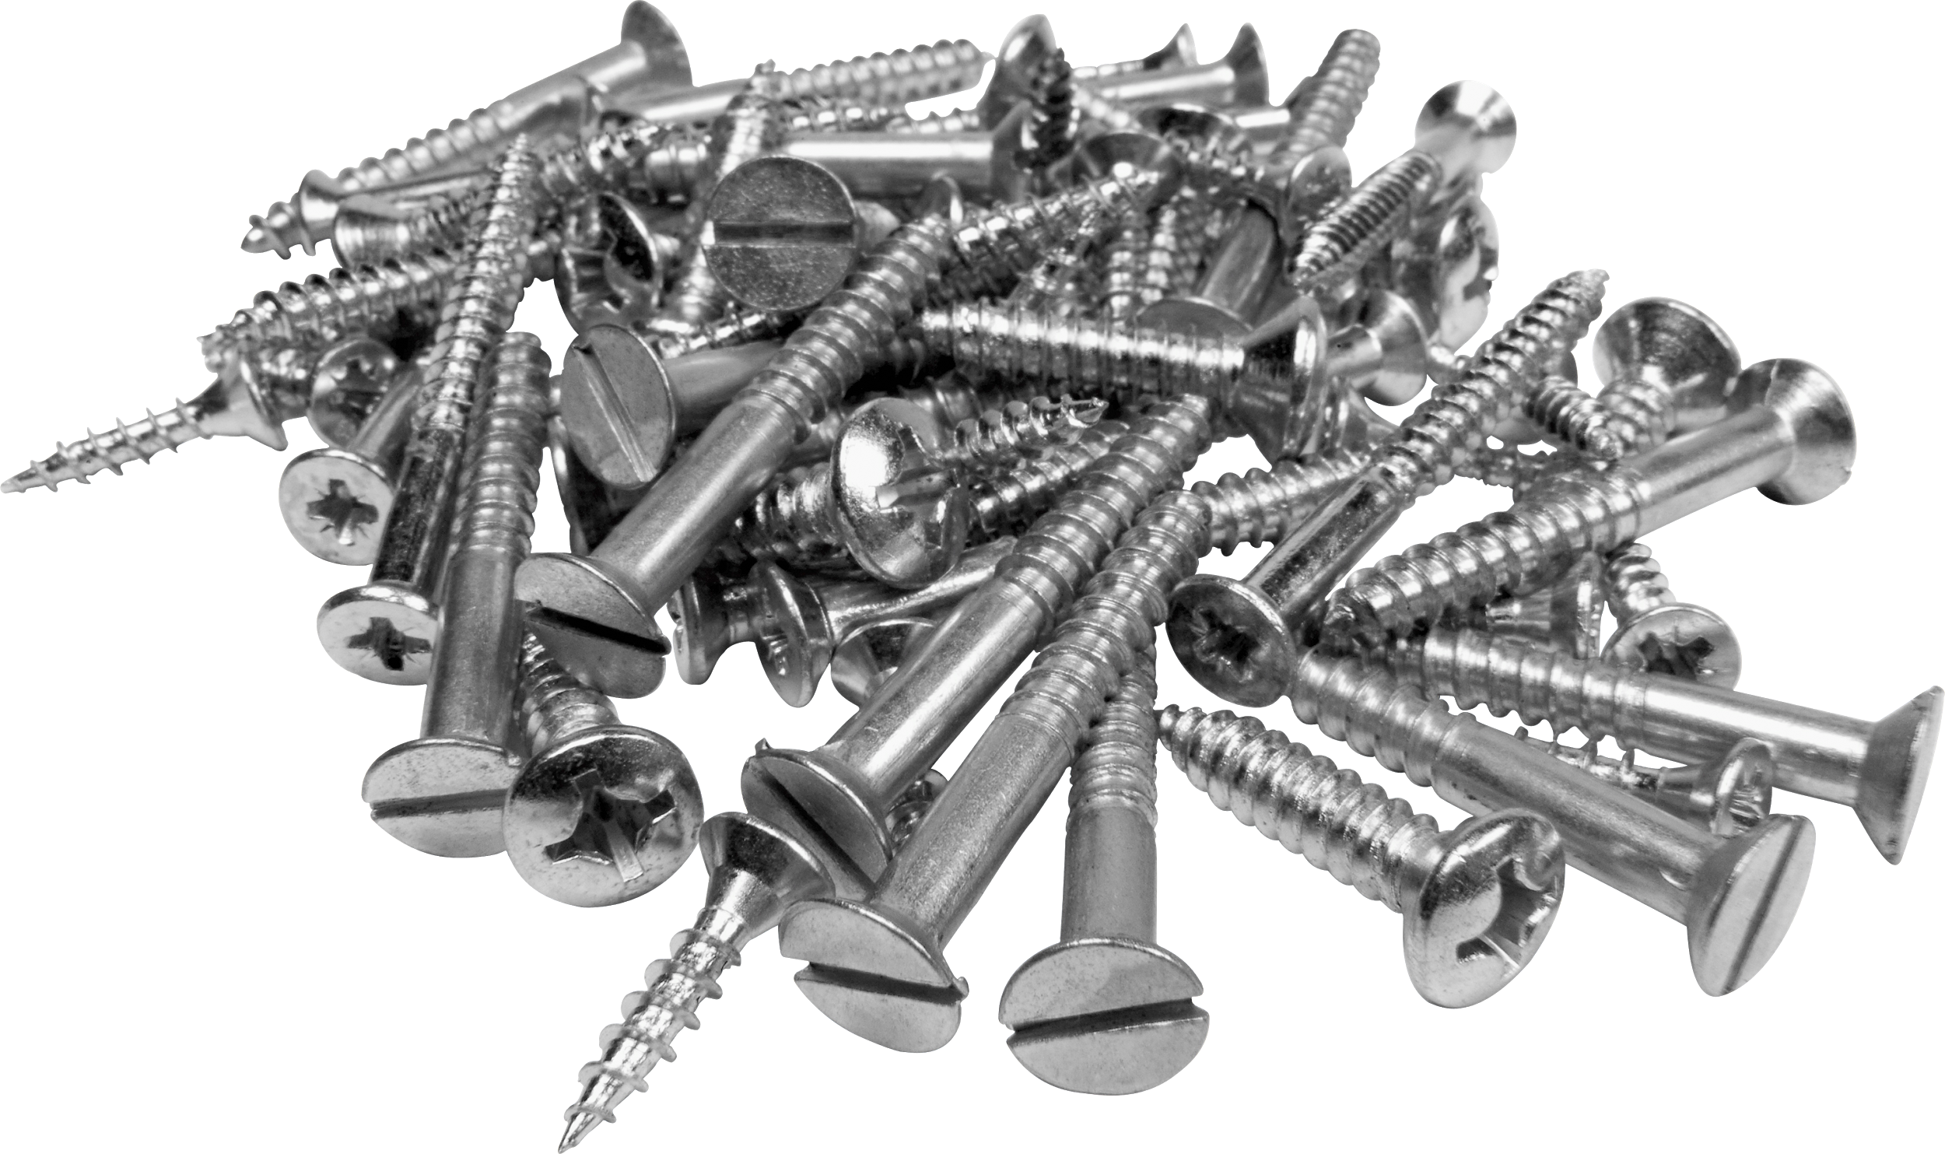
Materials List
Clay
Wood
Screws
Cup
Rubber bands
Small bouncy ball or marble

