Slide 1
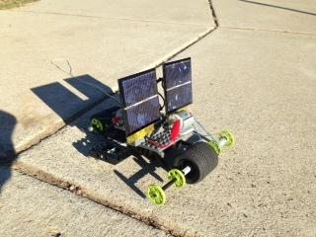
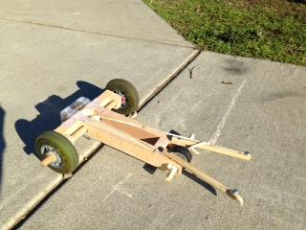
N.B.A. Nova AND N.B.A. Razor
The Energy efficient dynamic duo of the season!

Slide 2
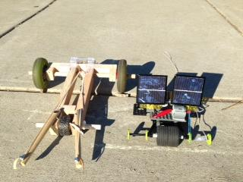
Our Two Primary Products
Razor
Nova

Slide 3
Brought to you by...
Novato Baller Association:
Quality you can enjoy on the go! It doesn’t feel like a long ride when you are buckled in a car by the N.B.A.! Not to mention our cars are cheap, energy efficient, and enjoyable by any family! Make sure to make way for the N.B.A.!

Slide 4
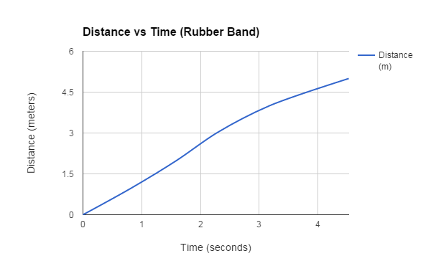
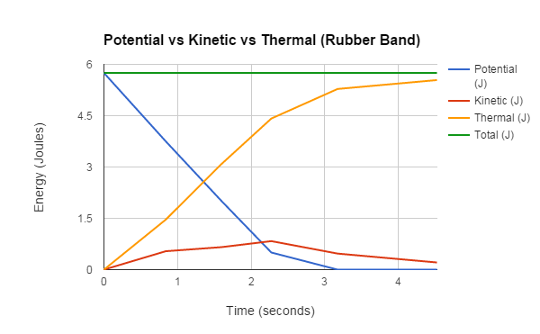
The N.B.A. Razor Performance Graphs

Slide 5
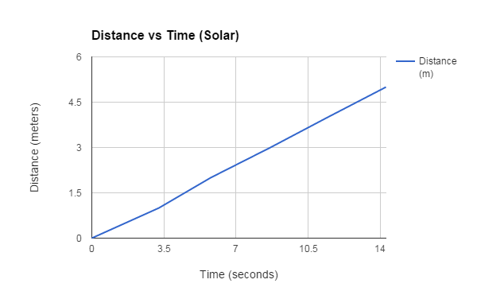
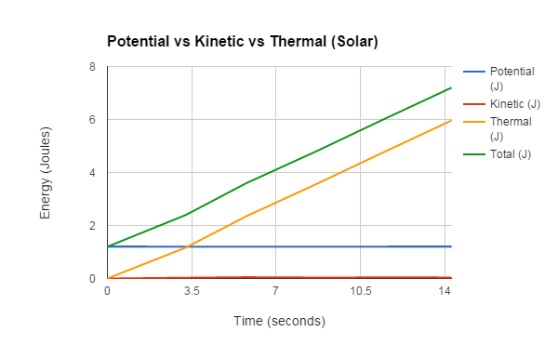
The N.B.A. Nova Performance Graphs

Slide 6
Comparing The Two Cars; The Data Tables
The Tables Of Our Cars
As you can see in our time calculations, the Razor is much faster than the Nova to reach 5 meters
The velocity of the razor was also much greater the entire time
Because the Razor is powered by rubber bands, the potential energy it has is greater at the beginning, because that is when the rubber bands release all their energy

Slide 7
More Comparing and Contrasting...
The final kinetic energy for each meter is also greater for the Razor because it converted more potential energy than the Nova
The Nova had more thermal energy which means that more energy was wasted due to frictions and other factors such as sound
The total of energy for the cars was, as you could see before, obviously greater with the Razor , but because the sun gives off constant energy, the Nova’s total energy soon overtook that of the Razor

Slide 8
Why Razor had more energy...
From the beginning of this project we knew that the solar energy from the Nova was much less efficient than the elastic energy from the Razor. If the two cars needed to drive long distances at a consistent speed the Nova would blow the Razor away. They both are exact opposites, yet achieve the same goal of the project with ease. The reason the Razor had more energy is because compared to our solar car, which only was powered by two, one volt, solar panels with weak motors, is that the elastic energy stored up and released from the Razor is much greater, as we proved with our data. Overall, the N.B.A. achieved two opposite, but equally special cars that will be greatly suited for Hyundai.

Slide 9
Differences In Cost...
Razor:
About $1 for all the wood
$10 for razor wheels
Total: $11
Notes: The cost is low and it gets the job done. What’s not to like?
Nova:
About $2.5 for the legos
Estimated $8 for the solar panels
$2 for the motors
Total: $12.5
Notes: Just slightly higher than the razor, but is still a good buy. Better for longer trips.

Slide 10
Reasons Why Our Cars Are #1:
Sleek and attractive frames that allows for smooth driving
Quality braking systems that allow maximum safety
Uses alternate forms of energy that cost nothing!
Never go to a gas station again!
Easy to start and they need no extra work
Affordable and easy to use

Slide 11
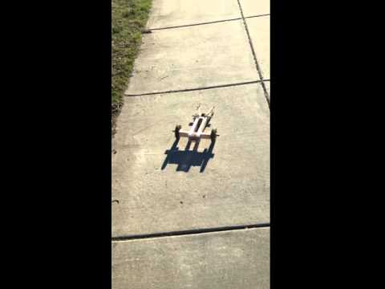
Razor goes Five Meters!

Slide 12
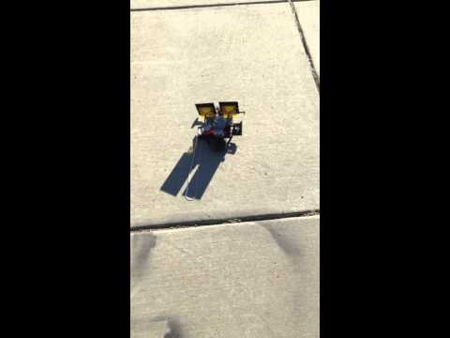
Nova Goes Five Meters!

Slide 13
By Nathan, Sebastian and Matt
We hope to see you in your local N.B.A dealership soon!

